Slide 1
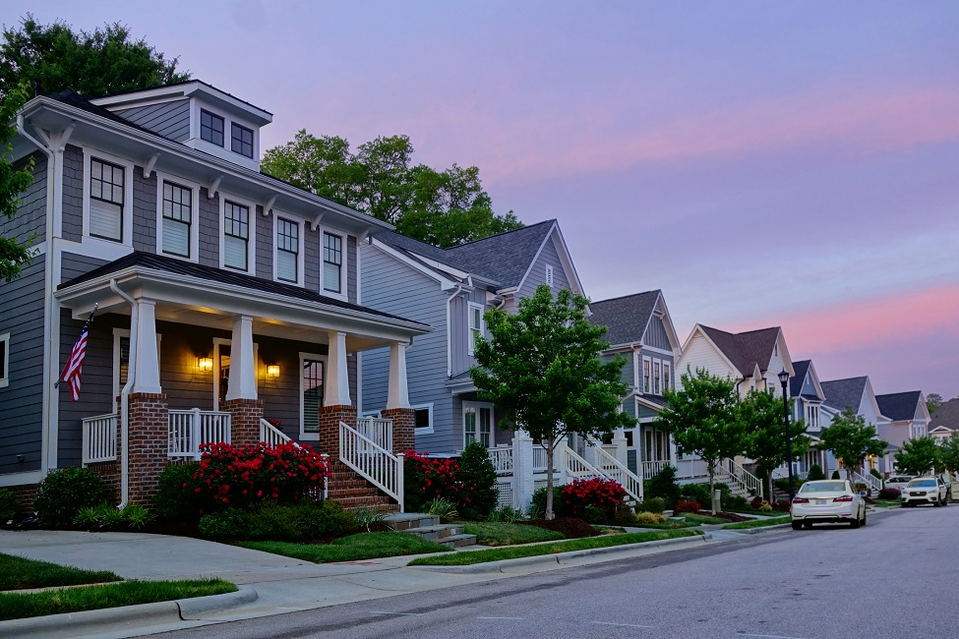
DRIVERS OF HOUSING PRICES
JEREMY KIBIRU GACHANJA (101167)
28/08/2022

Slide 2
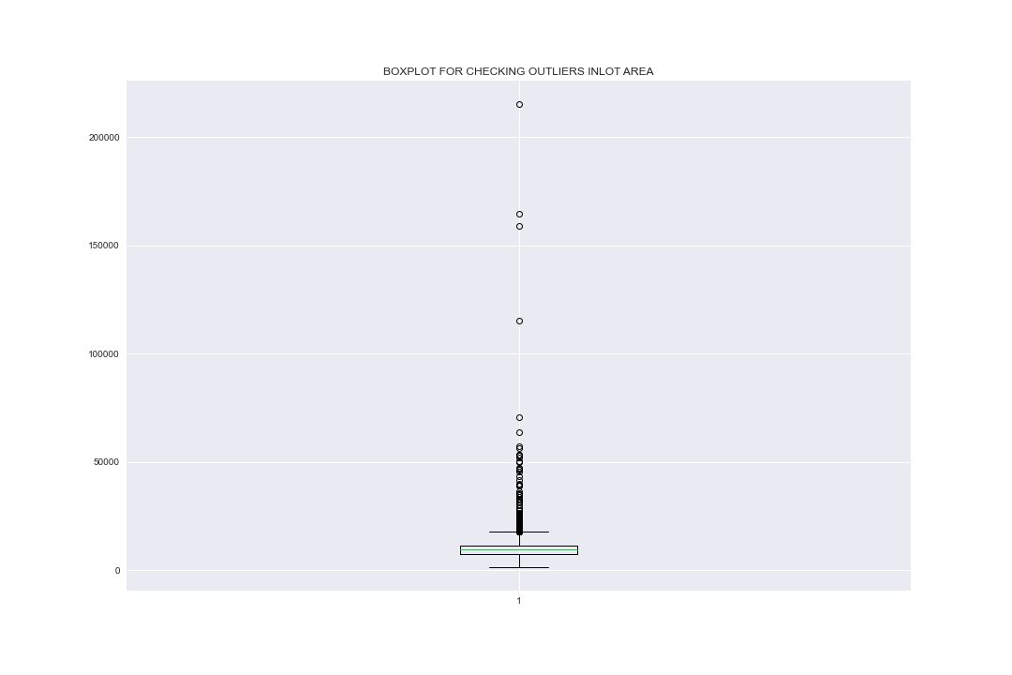
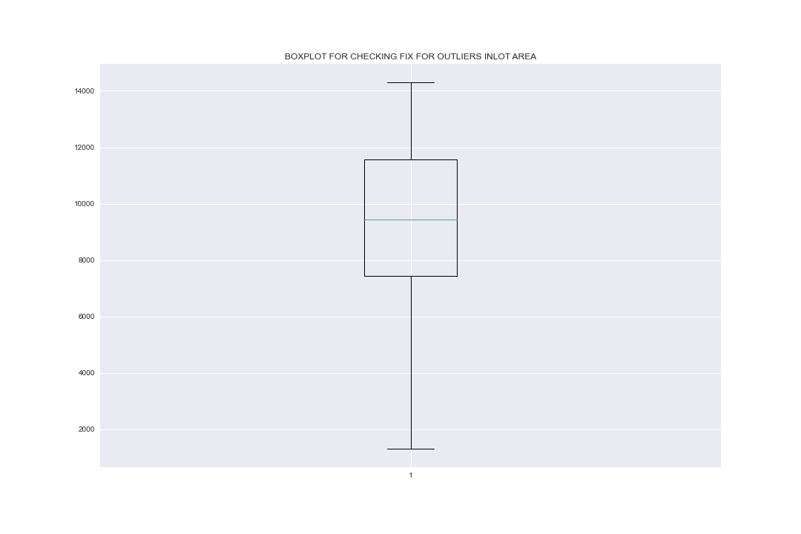
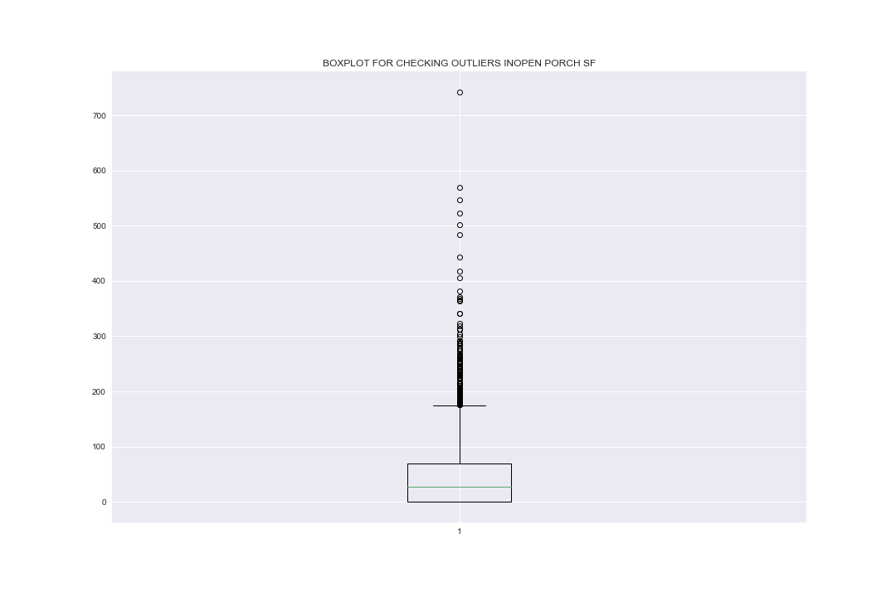
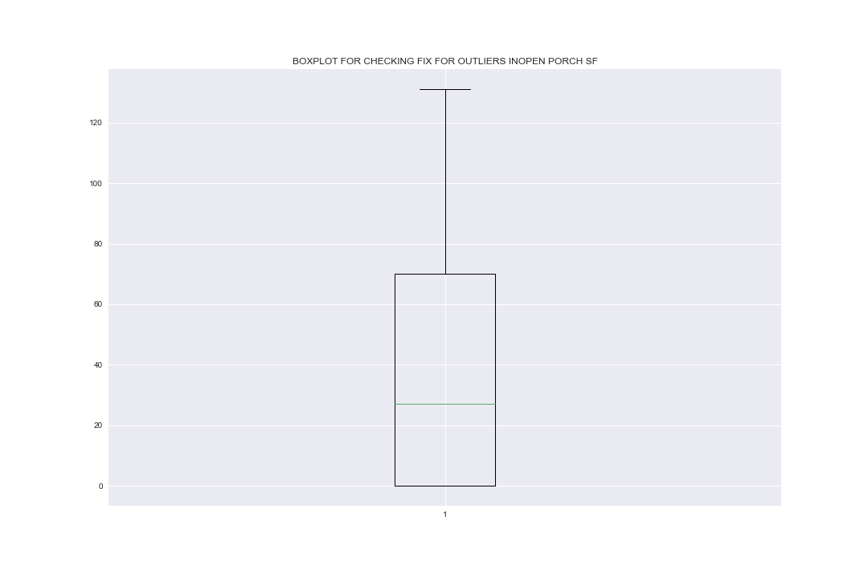
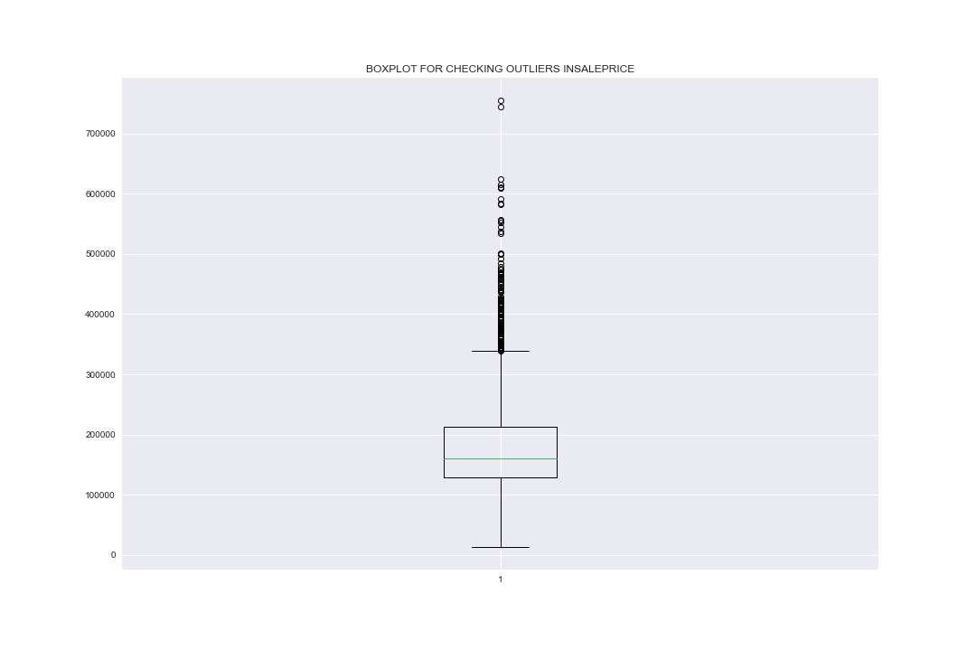
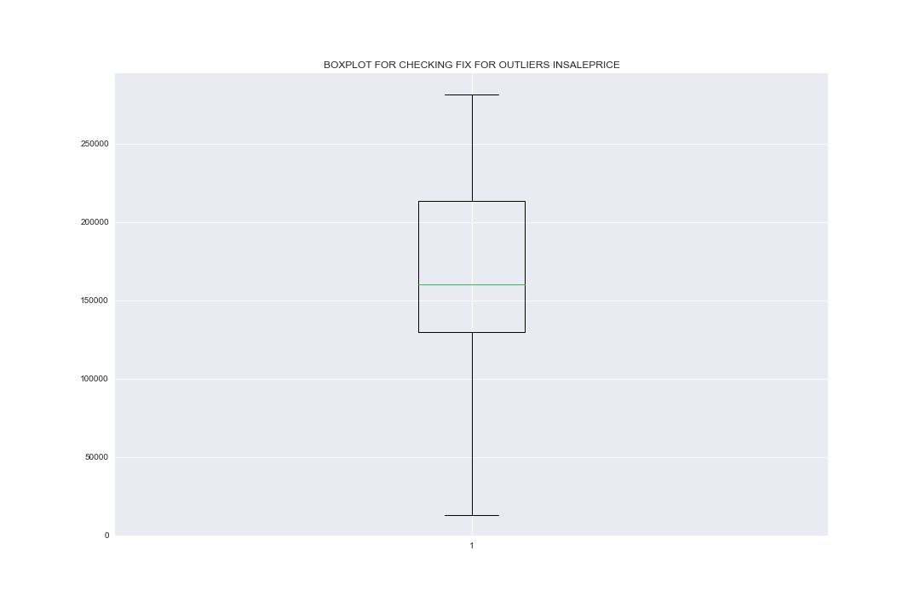
NATURE OF DATA AND OUTLIER CORRECTION
The scatter plots on the left are for the variables Sale-Price, Lot Area , Open Porch SF with outliers and after treating them for the outliers.
The method used to handle the outliers was percentile imputation. The outliers were replaced by the 90th percentile of each variable.
The data-frame had 2930 rows and 82 columns.
The data had 39 numerical columns and 43 categorical columns.
For variable PID and order they are just unique identifiers for the houses being sold. They are more or less a way of numbering the rows of the data frame and as such they do not contain information to be used in modelling.

Slide 3
MISSING VALUES
Before fixing missingness
After fixing missingness
catgorical
For the categorical columns the missing values were filled in using the modal frequency of the columns.
The mode was chosen since it is the most used method of filling in missing categorical data.
columns | Number of missing values | type
Pool QC | 2917 | object
Misc Feature | 2824 | object
Alley | 2732 | object
 | Pool QC | Misc Feature | Alley
count | 13 | 106 | 198
unique | 4 | 5 | 2
top | Ex | Shed | Grvl
freq | 4 | 95 | 120
 | Pool QC | Misc Feature | Alley
count | 2930 | 2930 | 2930
unique | 4 | 5 | 2
top | Ex | Shed | Grvl
freq | 2921 | 2919 | 2852
numerical
For the numerical columns, the mean could not be used for columns Lot Frontage and Mas Vnr Area since they both had outliers thus the missing values here were filled using the median.
For Garage Yr Blt the mode was used to fill in the missing values since it is possible some houses were built in the same year.
columns | Number of missing values | type
Lot Frontage | 490 | float64
Garage Yr Blt | 159 | float64
Mas Vnr Area | 23 | float64
 | Lot Frontage | Garage Yr Blt | Mas Vnr Area
count | 2440 | 2771 | 2907
mean | 69.22459 | 1978.132 | 101.8968
std | 23.36533 | 25.52841 | 179.1126
min | 21 | 1895 | 0
25% | 58 | 1960 | 0
50% | 68 | 1979 | 0
75% | 80 | 2002 | 164
max | 313 | 2207 | 1600
 | Lot Frontage | Garage Yr Blt | Mas Vnr Area
count | 2930 | 2930 | 2930
mean | 69.0198 | 1979.59 | 101.0969
std | 21.32642 | 25.56134 | 178.6345
min | 21 | 1895 | 0
25% | 60 | 1962 | 0
50% | 68 | 1983.5 | 0
75% | 78 | 2003 | 162.75
max | 313 | 2207 | 1600

Slide 4
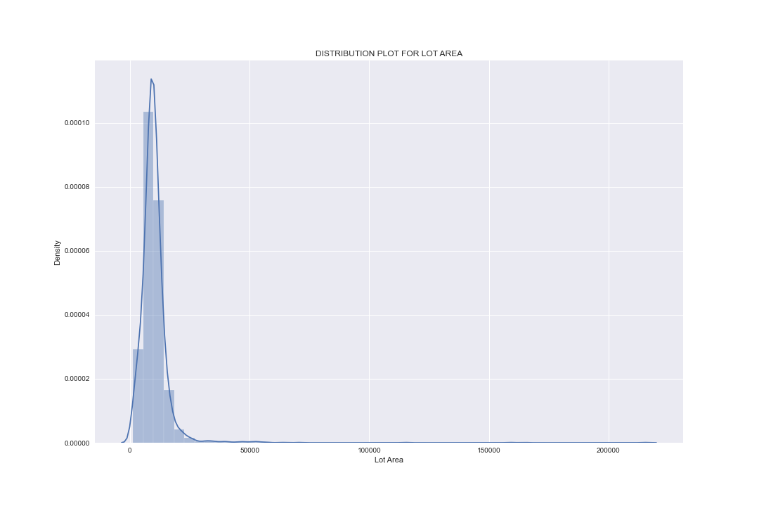
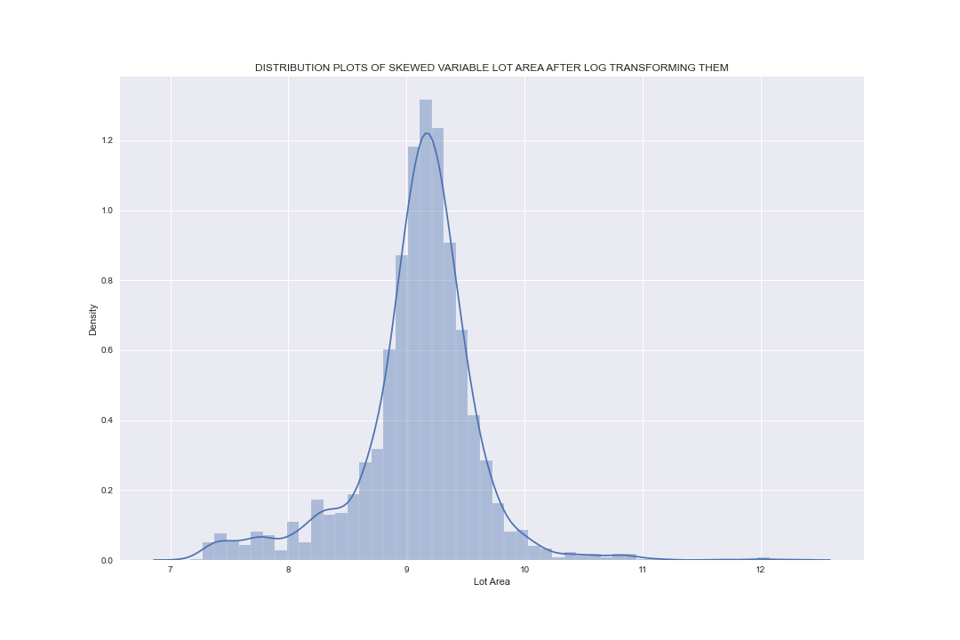
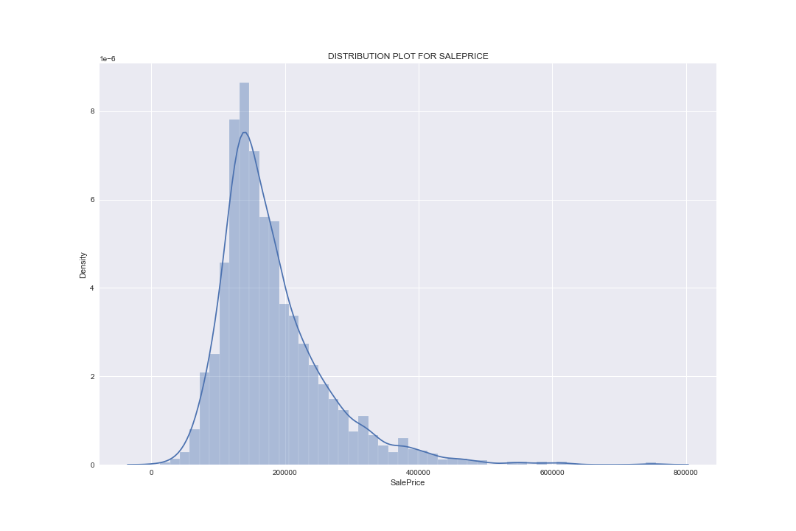
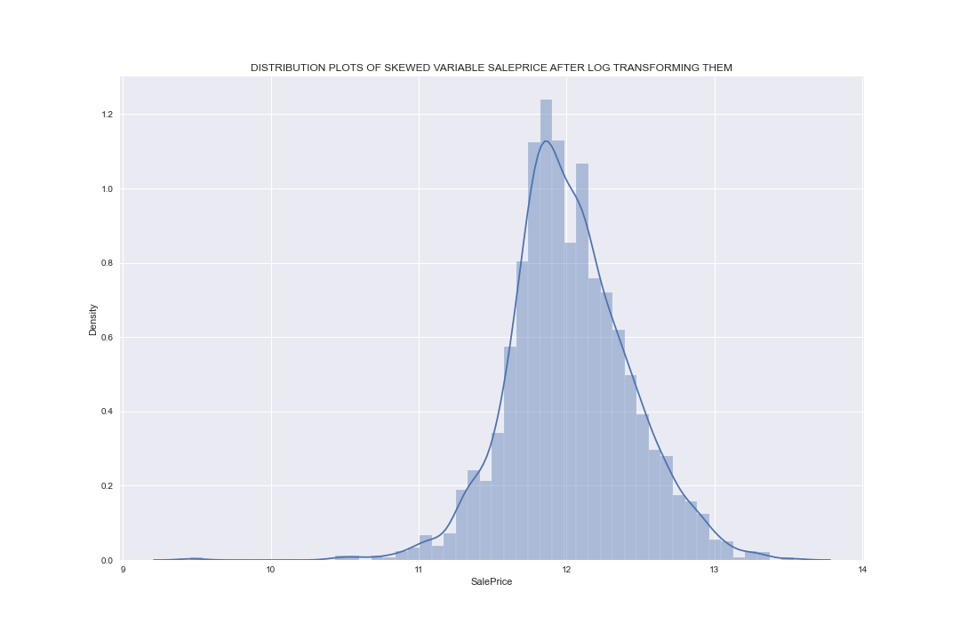
SKEWNESS AND HOT ENCODING
The columns chosen with high skewness were Lot Area and Sale Price. The transformations to correct their skewness were log transformations and MinMax scaling. Log transformations did the best job with regard to fixing the skewness.
 | Garage TypeN
count | 2773
mean | 2.283087
std | 1.790303
min | 0
25% | 1
50% | 1
75% | 5
max | 5
The green table above shows the summary statistics for the hot encoded Garage Type column.

Slide 5
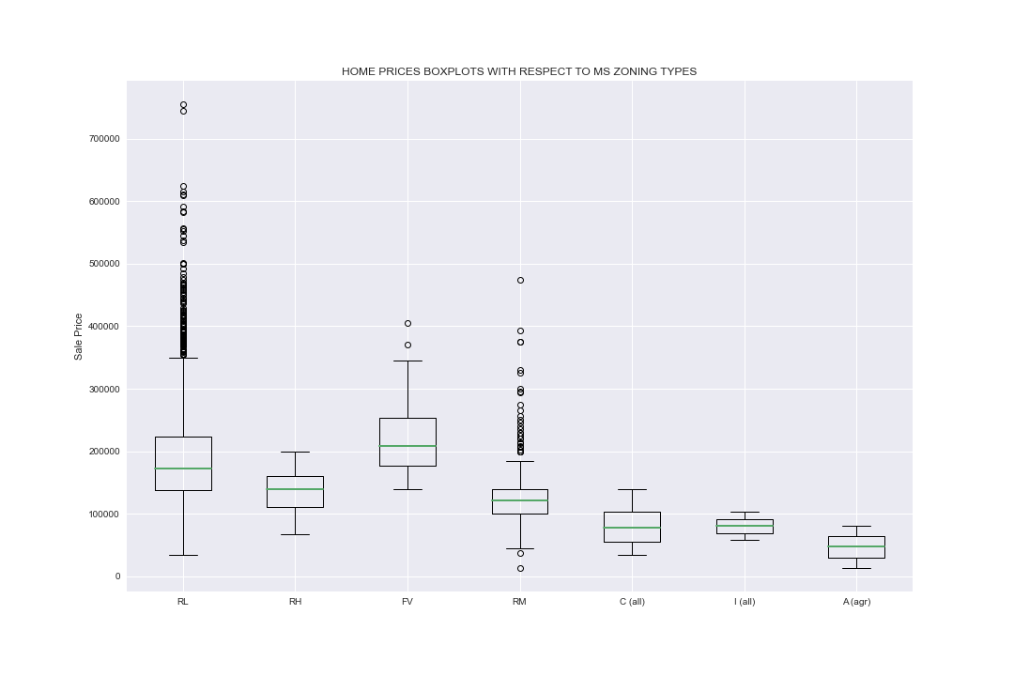
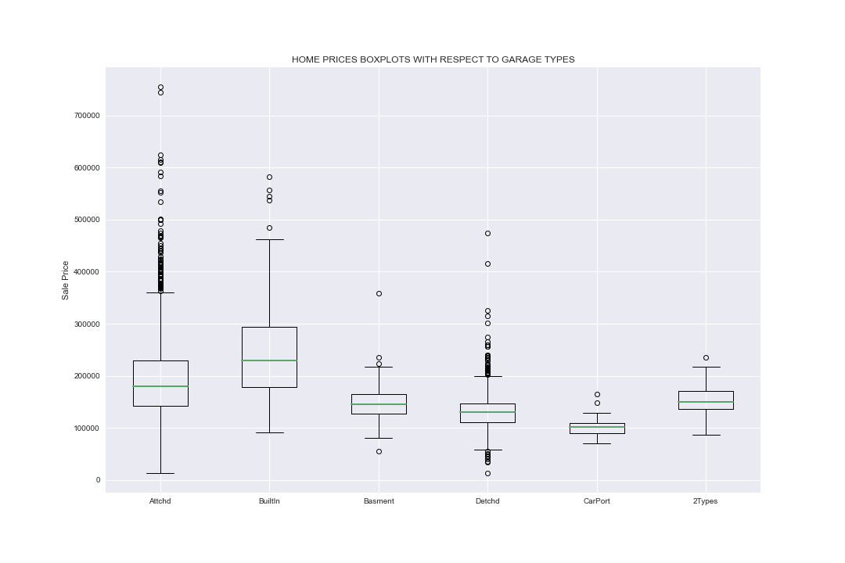
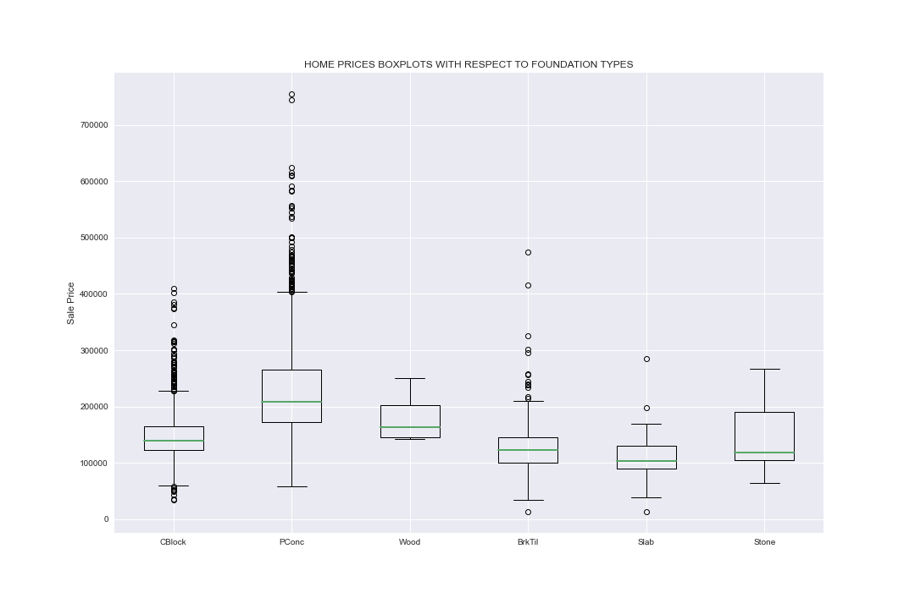
BIVARIATE ANALYSIS
The box plots above show price fluctuations with respect to MS Zoning, Foundation type and Garage Type.
From the boxplots the major driver of house prices may be Foundation type since they have the highest lowest first quartile compared to MS Zoning and Garage Type.

Slide 6
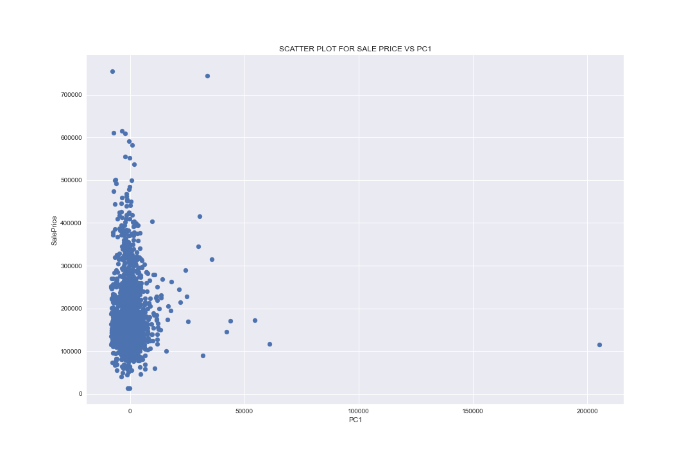
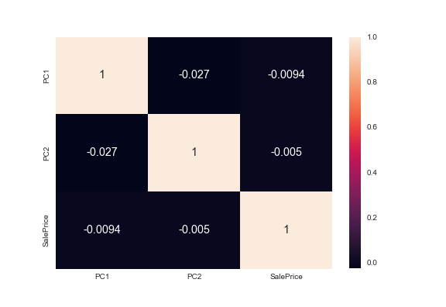
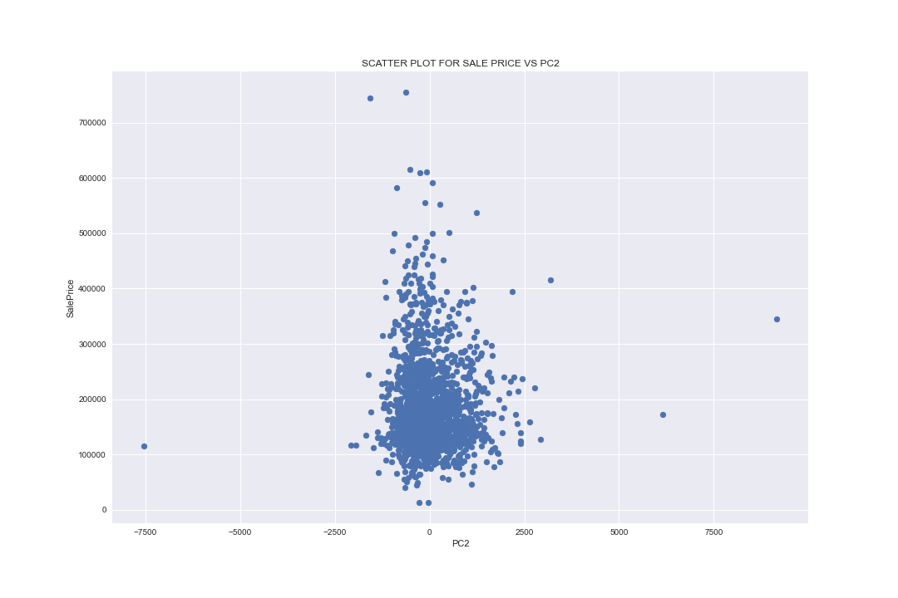
PRINCIPLE COMPONENT ANALYSIS
The scatter plots on the left show are for the sale-price against the first and second principle component that is (PC1 and PC2 ) respectively.
The principle component with the highest correlation with Sale-price is the first principle component. It has a correlation of -0.0094 with Sale-price.
To capture over 80% of the variation in Sale-price one principle component is enough.

